Slide 1
Project 9: EKF-based Localization with LRF
Presentation 5:
Results, implementation, project review
Notes:
Hello, this is our final presentation on project number 9: EKF-based localization with a LRF. This time we will present our results, the implementation and a project review

Slide 2
Outline
Results
Implementation
Prediction
Matching
Update
Project Review
Questions
Notes:
And basically, the outline is equal to the title of the presentation. I will start with by showing some results, before explaining how we actually implemented the extended Kalman Filter. Then in the end I will give you a project review from our perspective.
So let’s start with a nice video of our working EKF

Slide 3
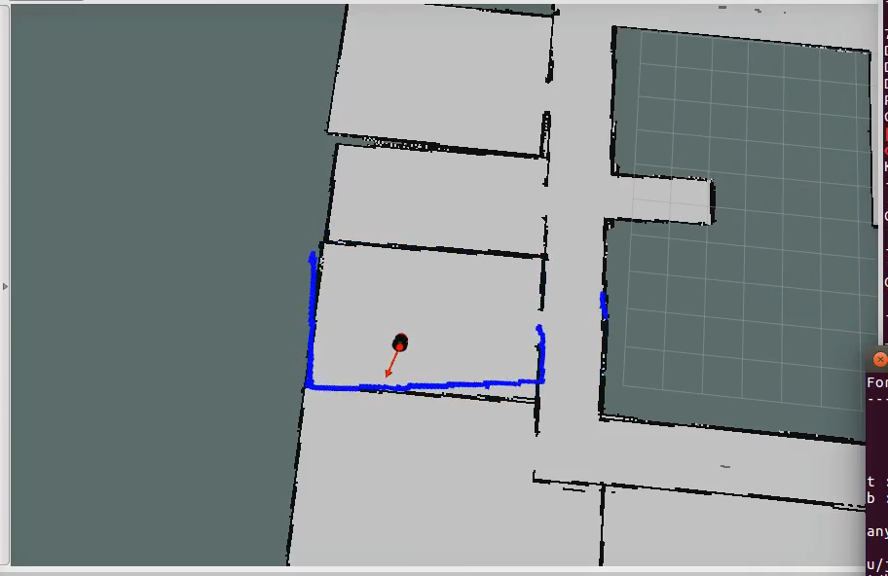
Results
Notes:
…

Slide 4
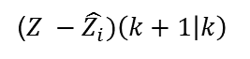


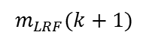
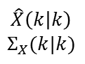
EKF Implementation
Update
Matching
$$\hat{X}\left(k | k\right)$$
$$Σ_{X}(k|k)$$
($Z −\hat{Z_{i}})\left(k+1 | k\right)$
Prediction
Motion model
Observation model
$$\hat{X}\left(k+1 | k\right)$$
$$Σ_{X}(k+1|k)$$
$$\hat{m}\left(k+1 | k\right)$$
Ray casting
ICP
$$m_{LRF}(k+1)$$
Odometry
Map
LRF
Notes:
So diving into the implementation: This is how we implemented the EKF.
- Prediction, Matching and Update. - Prediction uses odometry.
- observation model, includes ray casting algorithm and ICP
- Ray casting + map → predicted laser scan measurements - ICP: predicted + real laser measurements → difference between the real and the predicted observation. - matching + update

Slide 5
EKF Implementation
Update
Matching
$$\hat{X}\left(k | k\right)$$
$$Σ_{X}(k|k)$$
($Z −\hat{Z_{i}})\left(k+1 | k\right)$
Prediction
Motion model
Observation model
$$\hat{X}\left(k+1 | k\right)$$
$$Σ_{X}(k+1|k)$$
$$\hat{m}\left(k+1 | k\right)$$
Ray casting
ICP
$$m_{LRF}(k+1)$$
Odometry
Map
LRF
Notes:
The next slides will explain the implementation of each step in detail. First up, the motion model.

Slide 6
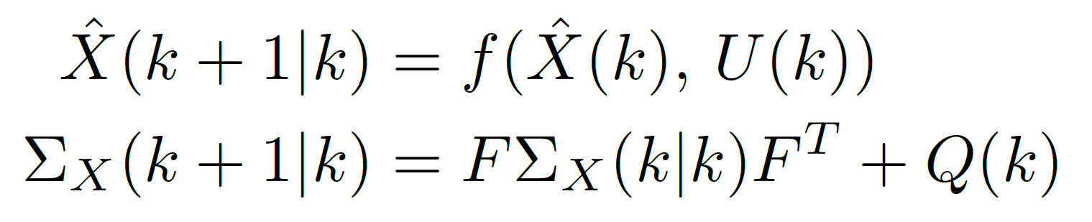
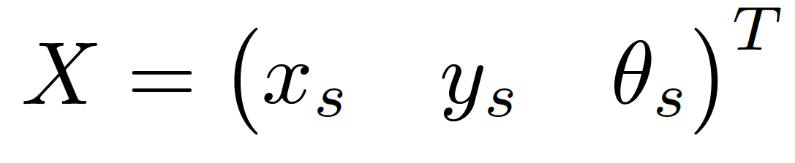
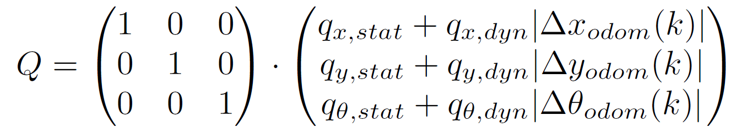
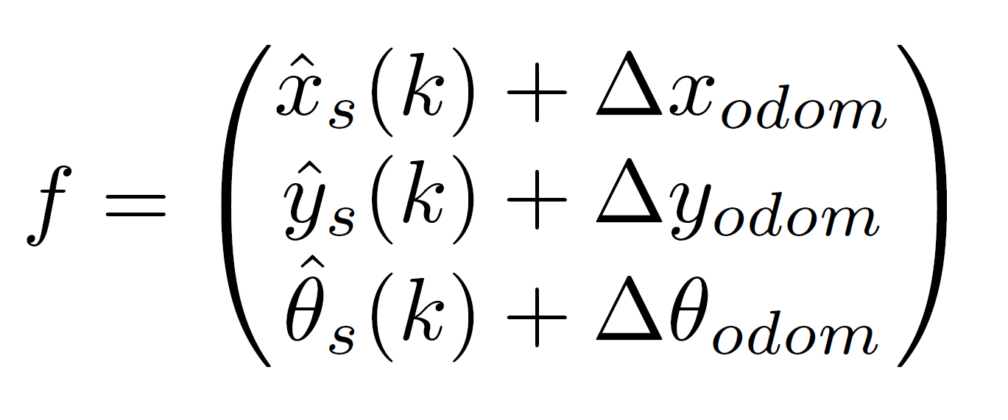
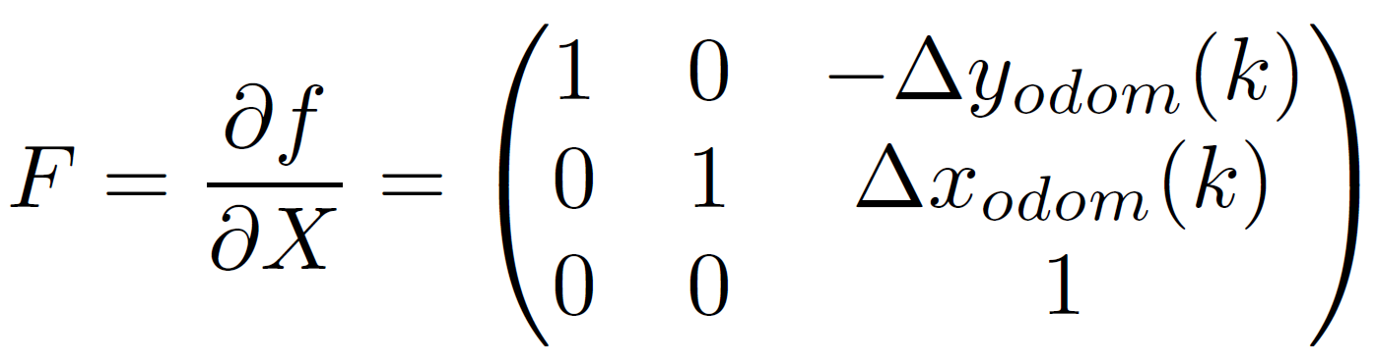
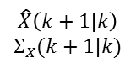
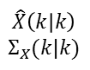
Motion Model
$$\hat{X}\left(k | k\right)$$
$$Σ_{X}(k|k)$$
Motion model
$$\hat{X}\left(k+1 | k\right)$$
$$Σ_{X}(k+1|k)$$
Odometry
Notes:
- required equations + ugly slide very useful to have the equations here.
- motion model predicts the next state with a specific covariance.
For doing so, you have to define a motion model, that fits your task and equipment. For us, using a wheeled robot, in a 2 dimensional scenario, the state is defined by a x and y coordinate + the theta angle around the z- axis.
For state prediction we use the odometry , so that our f function is the current state x,y,theta _s + the delta odometry.
The delta odometry is calculated as the difference between the last odometry state and the current one.
By doing so, we can avoid the error accumulation of the odometry. For calculating the covariance of the state prediction it is necessary to know the big F and the Q matrix. The big F is defined as derivation of f with respect to the state X, so you can easily understand the diagonal of the big F matrix we use.
The reason for the entries in the top right corner isn’t so obvious. The result from the original formulation of the small f, which then gets simplified by using the odometry to the here shown formulation. As theta influences the delta x and y_odom the big F has non zero entries in the top right corner.
For the noise of the state prediction, we currently use a dynamic approach, that is based on the idea, that the odometry error is bigger, if the robot moved a lot in the last time step. So if the robot does not move, we only add a very little static noise. If the robot moved, we add a dynamic part, that is determined by the amount of movement.

Slide 7
EKF Implementation
Update
Matching
$$\hat{X}\left(k | k\right)$$
$$Σ_{X}(k|k)$$
($Z −\hat{Z_{i}})\left(k+1 | k\right)$
Prediction
Motion model
Observation model
$$\hat{X}\left(k+1 | k\right)$$
$$Σ_{X}(k+1|k)$$
$$\hat{m}\left(k+1 | k\right)$$
Ray casting
ICP
$$m_{LRF}(k+1)$$
Odometry
Map
LRF
Notes:
The motion model wasn’t the big problem for us. We modified it at some points, but it actually never was totally wrong. But our observation model, at some point, was.

Slide 8
Observation Model
Important:
Only compare measurements that represent the same point
Think about each laser beam as a landmark
Comparing distances for each angle does not work
Observation model ideas:
Extract landmarks from laser scan
Extract line segments
Using point clouds
Extract landmarks from laser scan
Extract line segments
Using point clouds
Notes:
Because it is incredibly important, that only measurements that represent the same point in the real world get compared. That is pretty obvious, when you deal with landmarks, but if you have a laser scan with 720 beams, there a lot of ways to compare the measurements.
We started by comparing the distances of the predicted and real laser scan for each angle, but that does not work. The instinctive reason that you would not compare different landmarks, only because you saw them from different position in the same angle to you.
The mathematical reason is, that the EKF should use a well linearized observation model. But the comparing distances for each angle method, may lead to model that can not be represented by linearization.
Possible ways to implement a correct observation model are to extract landmarks from the map and the laser scan, or to extract line segments which is similar approach. We decided for a third idea. Using point clouds.

Slide 9
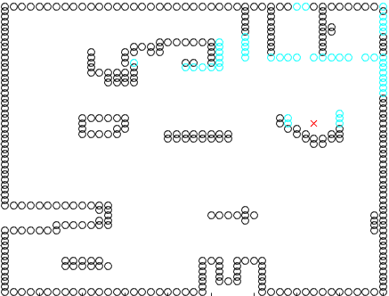
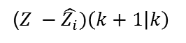
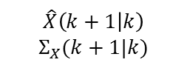

Ray casting
Use map to simulate laser scan in predicted position
Search starting angle until finding a occupied grid cell
Increase angle and repeat until reaching max angle
Return distance and angle
($Z −\hat{Z_{i}})\left(k+1 | k\right)$
Observation model
$$\hat{X}\left(k+1 | k\right)$$
$$Σ_{X}(k+1|k)$$
$$\hat{m}\left(k+1 | k\right)$$
Ray casting
ICP
$$m_{LRF}(k+1)$$
Map
LRF
Notes:
Predict laser scan at predicted position
Simulate each beam until first occupied grid cell is entered
Limit of precision is map resolution

Slide 10

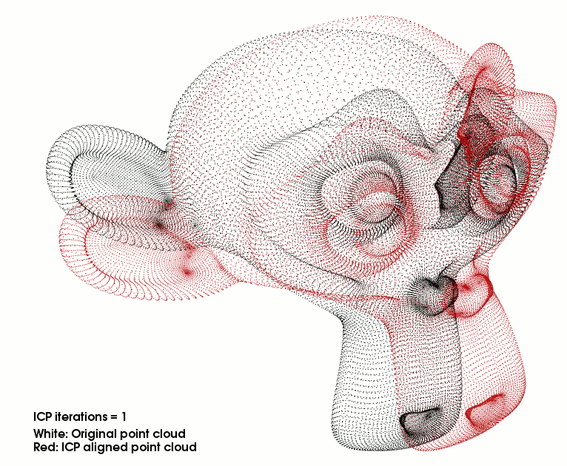

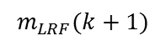
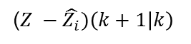
Iterative Closest Point Algorithm
Algorithm to minimize the difference between two point clouds
ICP transforms ray casting point cloud into the LRF one
Finds a transformation matrix to match the point clouds
($Z −\hat{Z_{i}})\left(k+1 | k\right)$
Observation model
$$\hat{m}\left(k+1 | k\right)$$
Ray casting
ICP
$$m_{LRF}(k+1)$$
Map
LRF
Notes:
Algorithm to minimize difference between two point clouds
Picture shows how powerful
ICP transforms predicted point cloud into LRF one
Returns 4 x 4 transformation matrix (3d rot + translation)
V can be extracted

Slide 11
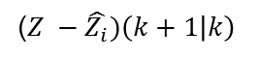
Iterative Closest Point Algorithm
ICP is a black box
Empirical values for a lot of parameters within ICP
One wrong ICP result can cause heavy problems
($Z −\hat{Z_{i}})\left(k+1 | k\right)$
Observation model
$$\hat{m}\left(k+1 | k\right)$$
Ray casting
ICP
$$m_{LRF}(k+1)$$
Map
LRF
Notes:
ICP is black box
Lot of parameters, that influence performance
Wrong ICP can even result in diverging EKF

Slide 12
EKF Implementation
Update
Matching
$$\hat{X}\left(k | k\right)$$
$$Σ_{X}(k|k)$$
($Z −\hat{Z_{i}})\left(k+1 | k\right)$
Prediction
Motion model
Observation model
$$\hat{X}\left(k+1 | k\right)$$
$$Σ_{X}(k+1|k)$$
$$\hat{m}\left(k+1 | k\right)$$
Ray casting
ICP
$$m_{LRF}(k+1)$$
Odometry
Map
LRF

Slide 13
Matching
To prevent wrong updates with outliers or wrong ICP transformation
Current mismatch conditions:
ICP does not converge
ICP does not match enough points
Notes:
Matching for preventing wrong updates
Current mismatch conditions:
ICP wasn’t able to converge or
ICP does not match enough points (Threshold 400 out of 720)
For kidnapping: After a certain amount of mismatches, heavily increase covariance, to make recovery possible

Slide 14
EKF Implementation
Update
Matching
$$\hat{X}\left(k | k\right)$$
$$Σ_{X}(k|k)$$
($Z −\hat{Z_{i}})\left(k+1 | k\right)$
Prediction
Motion model
Observation model
$$\hat{X}\left(k+1 | k\right)$$
$$Σ_{X}(k+1|k)$$
$$\hat{m}\left(k+1 | k\right)$$
Ray casting
ICP
$$m_{LRF}(k+1)$$
Odometry
Map
LRF

Slide 15
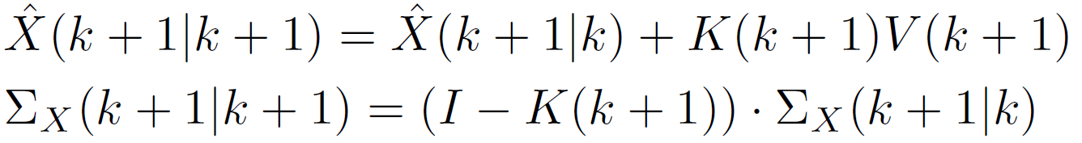

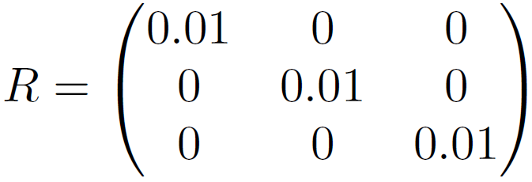
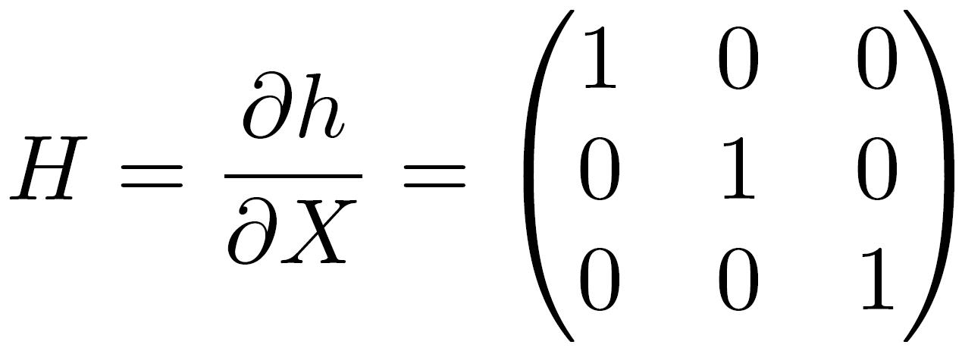
Update
Notes:
Already simplified with H= identitiy
H only identity because of ICP based observation model
Kalman only dependent of covariance and observation noise
Values in R determine trust in laser in comparison to odometry
Plan to make R dependent on ICP results

Slide 16
To Do List
Finish the report until Sunday night
Work towards poster presentation
Observation noise R dependent on ICP quality
Evaluate improvements by using the EKF
Create test scenario for odometry only vs. EKF
Try to improve kidnapping robustness
Notes:
Project wise:
As every other group of this shift : finish report & work towards poster presentation
Algorithm wise: - R dependent of ICP quality.
Evaluate EKF
Kidnapping robustness

Slide 17
Outline
Results
Implementation
Prediction
Matching
Update
Project Review
Questions

Slide 18
Project Review
Presentation 1
3 w
Presentation 2
3 w
Presentation 3
2 w
Brief idea about the project
First thoughts on the solution approach
Moving robot
Connected LRF
First map
Improved map
Gazebo installation
Coding ROS nodes
2 w
Presentation 4
2 w
Presentation 5
5 d
Report
First motion & observation model
Ray casting
More code
Reworked observation model
ICP
Working EKF
Improved kidnapping robustness
Comparison with odometry only
Notes:
Review

Slide 19
What we learned
There is a big gap between EKF equations and practical use
To do the transfer you need to understand the EKF
“Autonomous Systems“ class takes a lot time
A versatile group is challenging, but has a lot of benefits
Group projects are fun as long as you are on the same page

Slide 20
Outline
Results
Implementation
Prediction
Matching
Update
Project Review
Questions

Slide 21
Questions
Do we need to submit the code?

